Slide 1
Regression Analysis
Model Selection
Nicoleta Serban, Ph.D.
Professor
Stewart School of Industrial and Systems Engineering
Regularized Regression: Penalties

Slide 2

About This Lesson

Slide 3
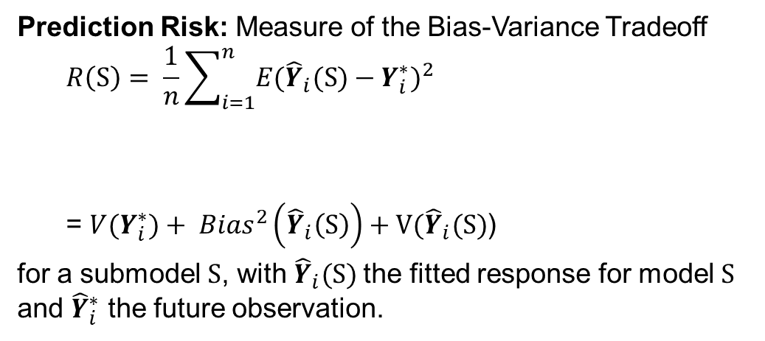
Bias-Variance Tradeoff
Prediction Risk: Measure of the Bias-Variance Tradeoff
$$R\left(S\right)= \frac{1}{n}\sum_{i=1}^{n}{E{({\hat{Y}}_{i}(S)−Y_{i}^{∗})}^{2}}$$
= ${V(Y}_{i}^{∗})+ {Bias}^{2}\left({\hat{Y}}_{i}\left(S\right)\right)+V({\hat{Y}}_{i}(S)$)
for a submodel S, with ${\hat{Y}}_{i}(S)$ the fitted response for model S and ${\hat{Y}}_{i}^{∗}$ the future observation.
Irreducible error
Mean Square Error
It is possible to find a model with lower MSE than the full model!
It is “generic” in statistics: introducing some bias often yields in a decrease in MSE.

Slide 4
Bias-Variance Tradeoff

Slide 5
Biased Regression: Penalties
Not all biased models are better.
We need a way to find “good” biased models!
Penalize large values of β s jointly
  Should lead to “multivariate” shrinkage of the vector β
Goal is really to penalize “complex” models
  Heuristically, “large” is interpreted as “complex model”
    If truth really is complex, this may not work!
      It will then be hard to build a good model anyways

Slide 6
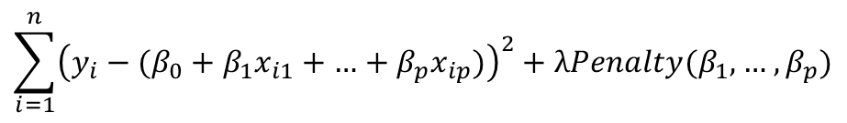
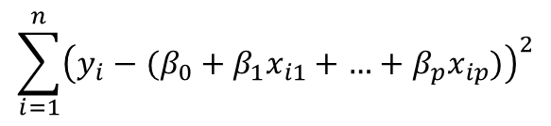
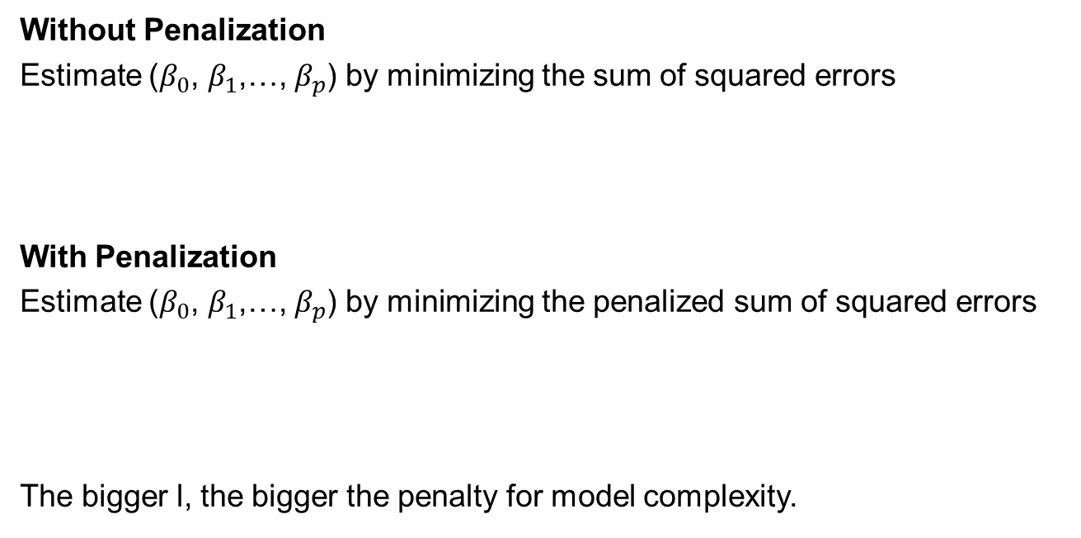
Regularized Regression
Without Penalization
Estimate ($β_{0}$, $β_{1}$,…, $β_{p}$) by minimizing the sum of squared errors
With Penalization
Estimate ($β_{0}$, $β_{1}$,…, $β_{p}$) by minimizing the penalized sum of squared errors
The bigger l, the bigger the penalty for model complexity.
$$\sum_{i=1}^{n}{{\left(y_{i}−(β_{0}+β_{1}x_{i1}+\text{…}+β_{p}x_{ip})\right)}^{2}}$$
$$\sum_{i=1}^{n}{{\left(y_{i}−(β_{0}+β_{1}x_{i1}+\text{…}+β_{p}x_{ip})\right)}^{2}}+λPenalty(β_{1},\text{…} ,β_{p})$$

Slide 7
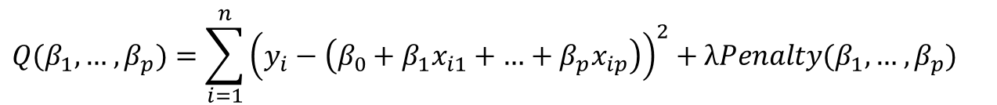
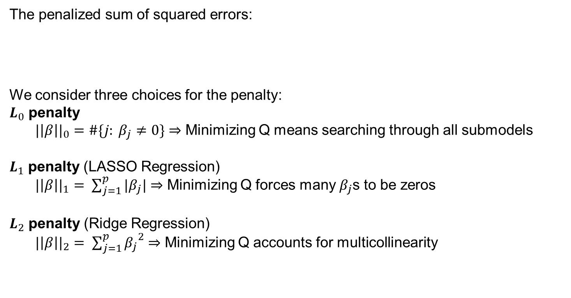
Regularized Regression (cont’d)
The penalized sum of squared errors:
We consider three choices for the penalty:
$L_{0}$ penalty
${|\left|β\right||}_{0}=\#\{j: β_{j}≠0\}$ ⇒ Minimizing Q means searching through all submodels
$L_{1}$ penalty (LASSO Regression)
${|\left|β\right||}_{1}= \sum_{j=1}^{p}{|β_{j}|}$ ⇒ Minimizing Q forces many $β_{j}$s to be zeros
$L_{2}$ penalty (Ridge Regression)
${|\left|β\right||}_{2}= \sum_{j=1}^{p}{{β_{j}}^{2}}$ ⇒ Minimizing Q accounts for multicollinearity
$$Q(β_{1},\text{…} ,β_{p})=\sum_{i=1}^{n}{{\left(y_{i}−\left(β_{0}+β_{1}x_{i1}+\text{…}+β_{p}x_{ip}\right)\right)}^{2}}+λPenalty(β_{1},\text{…} ,β_{p})$$

Slide 8
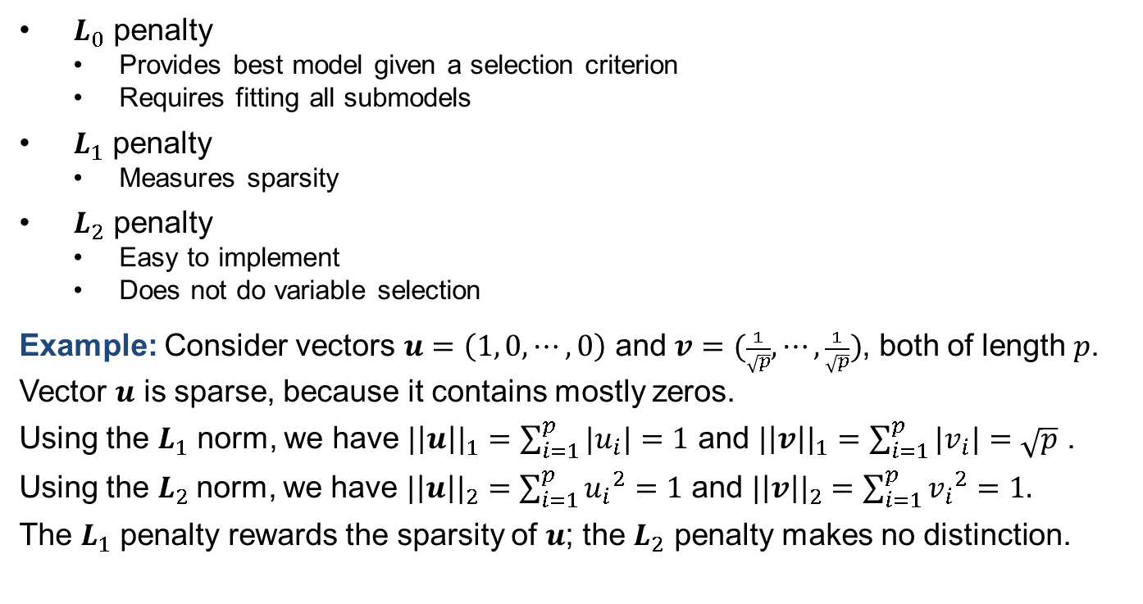
Comparing Penalties
$L_{0}$ penalty
  Provides best model given a selection criterion
  Requires fitting all submodels
$L_{1}$ penalty
  Measures sparsity
$L_{2}$ penalty
  Easy to implement
  Does not do variable selection
Example: Consider vectors $u=\left(1, 0,⋯,0\right)$ and $v=(\frac{1}{\sqrt{p}},⋯,\frac{1}{\sqrt{p}})$, both of length $p$.
Vector $u$ is sparse, because it contains mostly zeros.
Using the $L_{1}$ norm, we have ${|\left|u\right||}_{1}=\sum_{i=1}^{p}{|u_{i}|}=1$ and ${|\left|v\right||}_{1}=\sum_{i=1}^{p}{|v_{i}|}=\sqrt{p}$ .
Using the $L_{2}$norm, we have ${|\left|u\right||}_{2}=\sum_{i=1}^{p}{{u_{i}}^{2}}=1$ and ${|\left|v\right||}_{2}=\sum_{i=1}^{p}{{v_{i}}^{2}}=1.$
The $L_{1}$ penalty rewards the sparsity of $u$; the $L_{2}$ penalty makes no distinction.

Slide 9

Summary

